Slide 1

Django Template
Django Introduction (2)

Slide 2
Information
Agenda
System
01
Template Filters
Naïve Function on Filtering
02
Template Inheritance
“Include” and “Exclude”
03
Web Framework
Front-end Framework

Slide 3
Template Filter
Naïve Function on Filtering

Slide 4
Template Filters
Template filters are simple ways of altering the value of variables before they’re displayed. Filters look like this:
This displays the value of the {{ name }} variable after being filtered through the lower filter, which converts text to lowercase. Use a pipe (|) to apply a filter.
{{ name | lower }}

Slide 5
Filters
Filters can be chained—that is, the output of one filter is applied to the next. Here’s a common idiom for escaping text contents, and then converting line breaks to <p> tags:
{{ my_text|escape|linebreaks }}
{{ pub_date|date:"F j, Y" }}

Slide 6
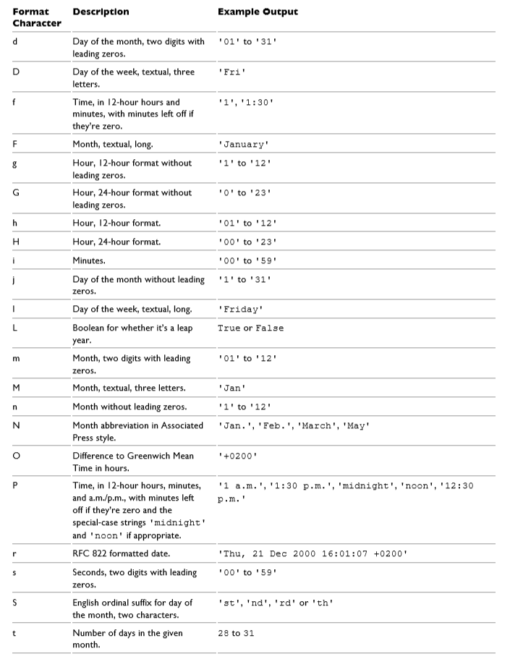
Filters
Format strings

Slide 7
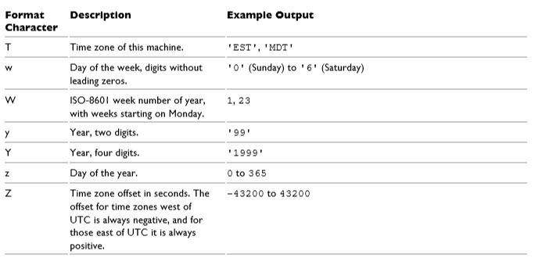
Filters

Slide 8
Filter Example
views.py
urls.py
HTML
Include the function "filter_func" in the file "views.py" in the folder "polls".
def filter_func(request):
name = "HUFS Yongin"
weekday = ["Monday", "Tuesday", "Wednesday", "Thursday", "Friday", "Saturday", "Sunday"]
temp = loader.get_template('hello_filter.html')
context = {
'name' : name,
'weekday' : weekday,
}
return HttpResponse(temp.render(context, request))

Slide 9
Filter Example
views.py
urls.py
HTML
Append path ('5/') in the 'urls.py' in the folder 'polls'
from django.urls import path
from polls import views
urlpatterns = [
path('', views.index, name = 'index'),
path('2/', views.if_else, name = 'if_else'),
path('3/', views.for_loop, name = 'for_loop'),
path('4/', views.ifequal_func, name = 'ifequal_function'),
path('5/', views.filter_func, name = 'filter_function'),
]

Slide 10
Filter Example
views.py
urls.py
HTML
<!DOCTYPE html>
<html>
<head>
<meta charset="EUC-KR">
<title>Hello World "Filter"</title>
</head>
<body>
<h1> Filter example {{ name | lower}} </h1>
{% for i in weekday %}
{{ i | first | upper }}
{% endfor %}
<br/>
{{ weekday | first | upper }}
<br/>
{{ weekday }}
<br/>
It is {% now "jS F Y H:i" %}
</body>
</html>
Create "hello_filter.html" in the folder "templates".
The symbol | is a separator to indicate the filter function that we are going to use.
For the date function, the example use the formatting string instead of filtering.

Slide 11
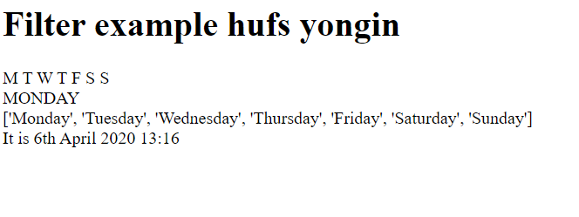
Result
http://127.0.0.1:8000/polls/5/

Slide 12
Template Inheritance
Inheritance in Django

Slide 13
Template Inheritance
The most powerful – and thus the most complex – part of Django’s template engine is template inheritance.
Template inheritance allows you to build a base “skeleton” template that contains all the common elements of your site and defines blocks that child templates can override.

Slide 14
Template Inheritance
For the basic of Template Inheritance, we will learn only include and extends functions.
include:
  Loads a template and renders it with the current context. This is a way of “including” other templates within a template.
  The template name can either be a variable or a hard-coded (quoted) string, in either single or double quotes.
extends:
  The extends tag is the key here. It tells the template engine that this template “extends” another template. When the template system evaluates this template, first it locates the parent

Slide 15
Template Inheritance (include)
Create a new folder “blog” under the folder “templates”
Create two HTML files; nav.html and datetime.html

Slide 16
Template Inheritance (include)
views.py
urls.py
HTML
datetime.html
<!DOCTYPE html>
<html lang="en">
<head>
<meta charset="UTF-8">
<title>Title</title>
</head>
<body>
{% include 'blog/nav.html' %}
{# This is a comment #}
{# check the existence of now variable in the template using if tag #}
{% if now %}
<p>Current date and time is {{ now }}</p>
{% else %}
<p>now variable is not available</p>
{% endif %}
<p>Current scheme: {{ request.scheme }}</p>
</body>
</html>
nav.html
<nav>
<a href="#">Home</a>
<a href="#">Blog</a>
<a href="#">Contact</a>
<a href="#">Career</a>
</nav>

Slide 17
Template Inheritance (include)
views.py
urls.py
HTML
Create a new method “today_is” in the “views.py” on the folder “polls”
def today_is(request):
now = datetime.datetime.now()
temp = loader.get_template('blog/datetime.html')
context = {
'now' : now,
}
return HttpResponse(temp.render(context, request))

Slide 18
Template Inheritance (include)
views.py
urls.py
HTML
Don’t forget to create link for this example
from django.urls import path
from polls import views
urlpatterns = [
path('', views.index, name = 'index'),
path('2/', views.if_else, name = 'if_else'),
path('3/', views.for_loop, name = 'for_loop'),
path('4/', views.ifequal_func, name = 'ifequal_function'),
path('5/', views.filter_func, name = 'filter_function'),
path('today/', views.today_is, name = 'today_is'),
]

Slide 19
Template Inheritance (include)
Run your web
http://localhost:8000/polls/today/

Slide 20
Template Inheritance (extends)
In this example, we are going to see the template setting using base directory.
There will be two HTML files.
One of the HTML file will use “extends” for the inheritance of particular tags into other file.

Slide 21
Template Inheritance (extends)
Create a new folder “blog2” under the folder “templates”
Create three HTML files; base.html, home.html, and blog.html

Slide 22
Template Inheritance (extends)
views.py
urls.py
HTML
The content of “base.html” is as follows.
<!DOCTYPE html>
<html>
<head>
<title>{% block title %}The Great Django Blog{% endblock %}</title>
</head>
<body>
<nav>
<a href="{%url 'home'%}">Home</a>
<a href="{%url 'blog'%}">Blog</a>
<a href="#">Contact</a>
<a href="#">Career</a>
</nav>
{% block content %}
{% endblock %}
<hr>
{% block footer %}
This is footer
{% endblock %}
</body>
</html>

Slide 23
Template Inheritance (extends)
views.py
urls.py
HTML
The content of “home.html” is as follows
{% extends "blog2/base.html" %}
{% block content %}
{% if now %}
<p>Current date and time is {{ now }}</p>
{% else %}
<p>now variable is not available</p>
{% endif %}
<p>Current scheme: {{ request.scheme }}</p>
<p>BASE_DIR : {{ base_dir }}</p>
{% endblock %}

Slide 24
Template Inheritance (extends)
views.py
urls.py
HTML
The content of “blog.html” is as follows
{% extends "blog2/base.html" %}
{% block content %}
This is a blog written by {{ writer }}
<p> Welcome and Enjoy </p>
{% endblock %}

Slide 25
Template Inheritance (extends)
views.py
urls.py
HTML
Create a new function in the “views.py” in the folder “polls” (function for “home.html”)
from django.conf import settings
def home(request):
now = datetime.datetime.now()
temp = loader.get_template('blog2/home.html')
context = {
'now' : now,
'base_dir': settings.BASE_DIR,
}
return HttpResponse(temp.render(context, request))

Slide 26
Template Inheritance (extends)
views.py
urls.py
HTML
Create a new function in the “views.py” in the folder “polls” (function for “blog.html”)
def blog(request):
writer = "Bernardo"
temp = loader.get_template('blog2/blog.html')
context = {
'writer' : writer,
}
return HttpResponse(temp.render(context, request))

Slide 27
Template Inheritance (extends)
views.py
urls.py
HTML
Create two new paths in the “urls.py” on the folder “polls”
from django.urls import path
from polls import views
urlpatterns = [
path('', views.index, name = 'index'),
path('2/', views.if_else, name = 'if_else'),
path('3/', views.for_loop, name = 'for_loop'),
path('4/', views.ifequal_func, name = 'ifequal_function'),
path('5/', views.filter_func, name = 'filter_function'),
path('today/', views.today_is, name = 'today_is'),
path('home/', views.home, name = 'home'),
path('blog/',views.blog, name = 'blog'),
]

Slide 28
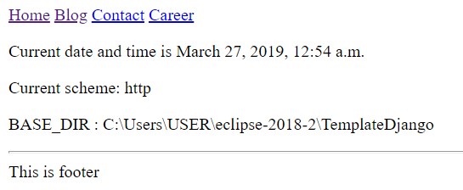
Template Inheritance (extends)
Run the web
http://localhost:8000/polls/home/

Slide 29
Explanation
<!DOCTYPE html>
<html>
<head>
<title>{% block title %}The Great Django Blog{% endblock %}</title>
</head>
<body>
<nav>
<a href="{%url 'home'%}">Home</a>
<a href="{%url 'blog'%}">Blog</a>
<a href="#">Contact</a>
<a href="#">Career</a>
</nav>
{% block content %}
{% endblock %}
<hr>
{% block footer %}
This is footer
{% endblock %}
</body>
</html>
The tag {%url ‘home’ %} means that the link when the reference is clicked is the path with a name “home”
It is the same for the other url which is ‘blog’. You can refer to the path name ‘blog’ in the urls.py

Slide 30
Explanation
<!DOCTYPE html>
<html>
<head>
<title>{% block title %}The Great Django Blog{% endblock %}</title>
</head>
<body>
<nav>
<a href="{%url 'home'%}">Home</a>
<a href="{%url 'blog'%}">Blog</a>
<a href="#">Contact</a>
<a href="#">Career</a>
</nav>
{% block content %}
{% endblock %}
<hr>
{% block footer %}
This is footer
{% endblock %}
</body>
</html>
There are three blocks; title, content, and footer.
The ‘base.html’ will remain the same while the contents will be depending on the html files. In this case, “home.html” and “blog.html”

Slide 31
Explanation
The “home.html” contains “extends” which will use the html of the given info (i.e., base.html)
Meanwhile, the content of the home.html will contain all statements inside the “block content”
The “request.scheme” is a way to know the scheme we used for executing the html file. It is the http.
{% extends "blog2/base.html" %}
{% block content %}
{% if now %}
<p>Current date and time is {{ now }}</p>
{% else %}
<p>now variable is not available</p>
{% endif %}
<p>Current scheme: {{ request.scheme }}</p>
<p>BASE_DIR : {{ base_dir }}</p>
{% endblock %}

Slide 32
Explanation
The same as “home.html”, “blog.html” extends the base.html.
The content of “blog.html” will be in the statements in between “block contents”
{% extends "blog2/base.html" %}
{% block content %}
This is a blog written by {{ writer }}
<p> Welcome and Enjoy </p>
{% endblock %}

Slide 33
Web Framework
User Interface (Front-End) Framework

Slide 34
Web Framework – Template with CSS
Web Framework provides a style template so everybody can use immediately
Style is related to CSS (Cascade Styling Sheet).
Basic CSS is related to the BODY TAG

Slide 35
Example with simple CSS and table
views.py
urls.py
HTML
Add the function "index2" into the file "views.py" in the folder "polls".
def index2(request):
name = 'HUFS'
cities = [
{'name': 'Mumbai', 'population': '19,000,000', 'country': 'India'},
{'name': 'Calcutta', 'population': '15,000,000', 'country': 'India'},
{'name': 'New York', 'population': '20,000,000', 'country': 'USA'},
{'name': 'Chicago', 'population': '7,000,000', 'country': 'USA'},
{'name': 'Tokyo', 'population': '33,000,000', 'country': 'Japan'},
]
temp = loader.get_template('tablecss.html')
context = {
'name' : name,
'cities' : cities,
}
return HttpResponse(temp.render(context, request))

Slide 36
Example with simple CSS and table
views.py
urls.py
HTML
Add path (‘tablecss/') in the "urls.py" in the folder "polls"
from django.urls import path
from polls import views
urlpatterns = [
path('', views.index, name = 'index'),
path('2/', views.if_else, name = 'if_else'),
path('3/', views.for_loop, name = 'for_loop'),
path('4/', views.ifequal_func, name = 'ifequal_function'),
path('5/', views.filter_func, name = 'filter_function'),
path('today/', views.today_is, name = 'today_is'),
path('home/', views.home, name = 'home'),
path('blog/',views.blog, name = 'blog'),
path('tablecss/', views.index2, name = 'index2'),
]

Slide 37
Example with simple CSS and table
views.py
urls.py
HTML
Create “tablecss.html" in the folder "templates".
<!DOCTYPE html>
<head>
<title>HTML and CSS "Hello World"</title>
<style>
body {
background-color: #2D2D2D;
}
h1 {
color: #C26356;
font-size: 30px;
font-family: Menlo, Monaco, fixed-width;
}
p {
color: white;
font-family: "Source Code Pro", Menlo, Monaco, fixed-width;
}
</style>
</head>
<body>
<h1>Hello World Example</h1>
<p>This is a very basic "Hello World" example made up in HTML and CSS. See if you can change the size of the header text above.</p>
<table border=1>
<tr>
<th> <p>City Name </p></th>
<th> <p>Population </p></th>
<th> <p>Country </p></th>
</tr>
{% for city in cities %}
<tr>
<td> <p> {{city.name}} </p></td>
<td> <p> {{city.population}} </p> </td>
<td> <p> {{city.country}} <p></td>
</tr>
{%endfor%}
</table>
</body>
</html>

Slide 38
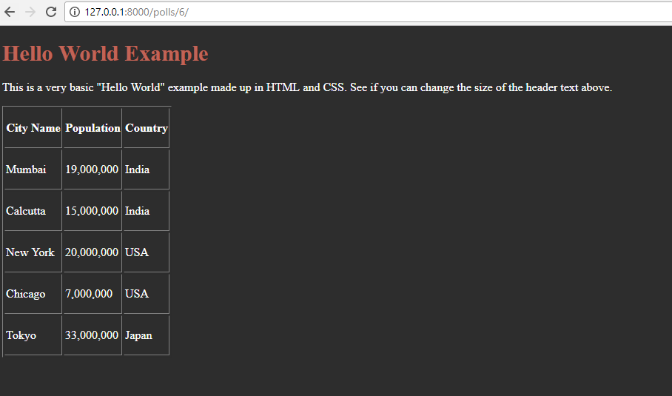
Execute
Note: it is a better practice to put the CSS and JS in a static form. It will be explained in later section

Slide 39
Web User Interface (UI) (Front-end) Framework
Web design requires a lot of efforts
Different purpose require different types of web
  E-commerce vs Government Site
  Blog vs Data Visualization Site
Devices are varied
  Mobile Web
  Gadget Web
OS-based Web-browser
  Ms. Windows
  IoS
  Linux
  Android

Slide 40
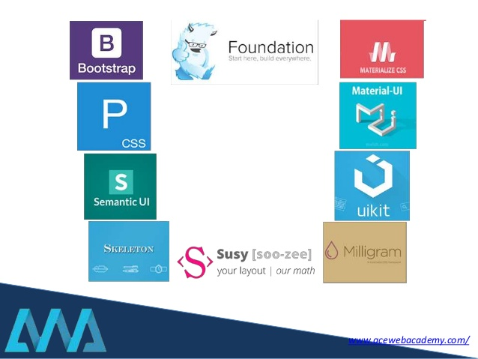
Web User Interface (UI) (Front-end) Framework
Using a framework will assist the development phase
Some of the existing framework:
  Bootstrap (by Twitter) (https://getbootstrap.com/)
  Foundation (ZURB) (https://get.foundation/)
  Semantic UI (https://semantic-ui.com/)
  Pure, by Yahoo! (https://purecss.io/)
  Uikit (https://getuikit.com/v2/)
Run Demo:
https://bootstrapstudio.io/

Slide 41
Web User Interface (UI) (Front-end) Framework
How to select the best framework?
  Usage Context (CRUD operation, analysis, visualization, etc.)
  License (Open Source, etc.)
  Software pattern (MVC, MVA, MVP, etc.)
  Hosting Requirement (setup and non-setup requirement)
  Ease of Installation
  Learning Curve
  Core Library
  Database Abstraction
  Documentation
  Community
  Bug Fixes / Updates
  Ease of Creating an Extension & Availability

Slide 42
Basic Bootstrap
Head Section
  We can connect to Bootstrap in two particular ways: Package Installation or Content Delivery Network (CDN)
  Package Installation: download bootstrap and place the package in your project
  Content Delivery Network: Place the JavaScript file in the Head Section
Body Section
  The “container” class is essential. Everything needs to be inside of it.
  The “row” class is almost as important. Use it to specify groupings of columns.
  Finally, there are a number of classes named with the pattern col-?-?.

Slide 43
<head> tag
<!DOCTYPE html>
<head>
<meta name="viewport" content="width=device-width, initial-scale=1.0">
<!-- CSS -->
<link rel="stylesheet" href="https://stackpath.bootstrapcdn.com/bootstrap/4.3.1/css/bootstrap.min.css" >
<!-- JS -->
<script src="https://stackpath.bootstrapcdn.com/bootstrap/4.3.1/js/bootstrap.min.js" ></script>
</script>
</head>

Slide 44
“Contact” by Bootstrap
views.py
urls.py
HTML
Create “contact.html”
<!DOCTYPE HTML PUBLIC "-//W3C//DTD HTML 4.01//EN" "http://www.w3.org/TR/html4/strict.dtd">
<head>
<title>Contact Us</title>
<link rel="stylesheet" type="text/css" href="https://cdn.datatables.net/1.10.19/css/dataTables.bootstrap.min.css"/>
<link rel="stylesheet" href="https://maxcdn.bootstrapcdn.com/bootstrap/3.3.7/css/bootstrap.min.css">
<script type="text/javascript" src="https://cdn.datatables.net/r/ju-1.11.4/jqc-1.11.3,dt-1.10.8/datatables.min.js"></script>
</head>
<!-- Default form contact top-->
<form class="text-center border border-light p-5" action="#!">
<p class="h4 mb-4">Contact us</p>
<!-- Name -->
<input type="text" id="defaultContactFormName" class="form-control mb-4" placeholder="Name">
<!-- Email -->
<input type="email" id="defaultContactFormEmail" class="form-control mb-4" placeholder="E-mail">
<!-- Subject -->
<label>Subject</label>
<select class="browser-default custom-select mb-4">
<option value="" disabled>Choose option</option>
<option value="1" selected>Feedback</option>
<option value="2">Report a bug</option>
<option value="3">Feature request</option>
<option value="4">Feature request</option>
</select>
<!-- Message -->
<div class="form-group">
<textarea class="form-control rounded-0" id="exampleFormControlTextarea2" rows="3" placeholder="Message"></textarea>
</div>
<!-- Copy -->
<div class="custom-control custom-checkbox mb-4">
<input type="checkbox" class="custom-control-input" id="defaultContactFormCopy">
<label class="custom-control-label" for="defaultContactFormCopy">Send me a copy of this message</label>
</div>
<!-- Send button -->
<button class="btn btn-info btn-block" type="submit">Send</button>
</form>
<!-- Default form contact bottom-->

Slide 45
“Contact” by Bootstrap
views.py
urls.py
HTML
Create a new function “contact” in the “views.py”
def contact(request):
writer = "Bernardo"
temp = loader.get_template('contact.html')
context = {
'writer' : writer,
}
return HttpResponse(temp.render(context, request))

Slide 46
“Contact” by Bootstrap
views.py
urls.py
HTML
Create two new paths in the “urls.py” on the folder “polls”
from django.urls import path
from polls import views
urlpatterns = [
path('', views.index, name = 'index'),
path('2/', views.if_else, name = 'if_else'),
path('3/', views.for_loop, name = 'for_loop'),
path('4/', views.ifequal_func, name = 'ifequal_function'),
path('5/', views.filter_func, name = 'filter_function'),
path('today/', views.today_is, name = 'today_is'),
path('home/', views.home, name = 'home'),
path('blog/',views.blog, name = 'blog'),
path('tablecss/', views.index2, name = 'index2'),
path('contact/',views.contact, name = 'contact'),
]

Slide 47
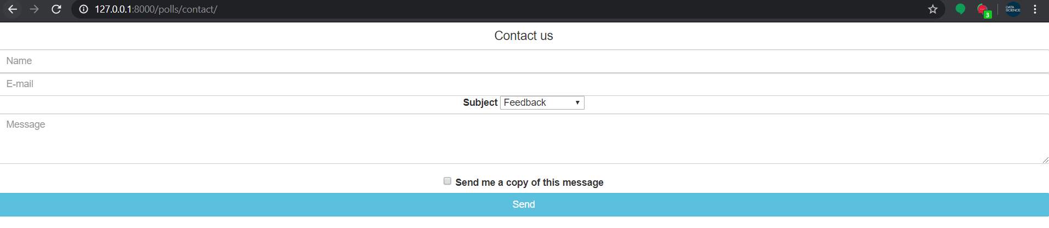
Result
http://127.0.0.1:8000/polls/contact/

Slide 48
“Contact” by Bootstrap - Additional
CODE in Page 37 <!-- Default form contact top -->
<div class = "container">
<div class="row">
<div class="col-md-4">
CODE in the BODY (Page 37)
</div>
</div>
</div>
CODE in Page 37 <!-- Default form contact bottom-->

Slide 49
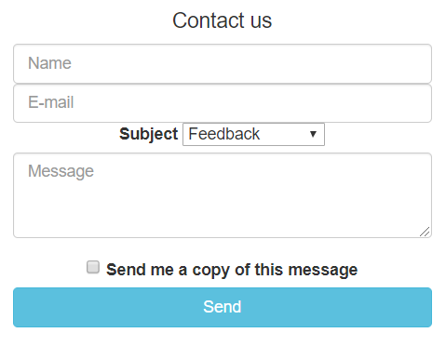
Result
http://127.0.0.1:8000/polls/contact/

Slide 50
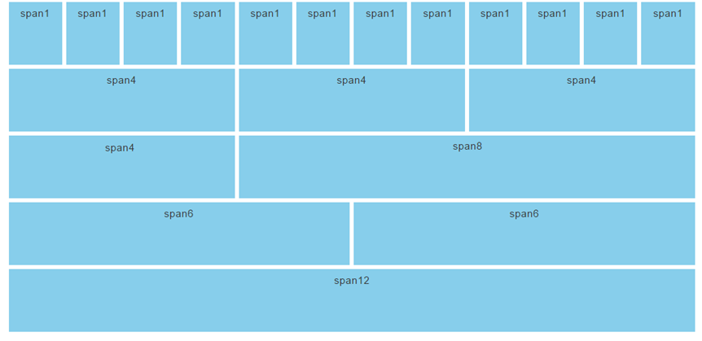
Spans are indicated in units of 12ths
In bootstrap, the column spans always need to add up to 12

Slide 51
Grid Classes
To specify a particular column’s width, we specify both the grid class, and the span of the column.
The Bootstrap grid system has four classes:
  xs (Extra small - for phones)
  sm (Small - for tablets)
  md (Medium - for typical desktops/laptops)
  lg (Large for larger desktops)

Slide 52
Some sample code for a 3 column layout
<div class="container">
<div class="row">
<div class="col-md-4">Column A</div>
<div class="col-md-4">Column B</div>
<div class="col-md-4">Column C</div>
</div>
</div>

Slide 53
Contextual Colors and Backgrounds
Bootstrap gives us contextual classes for background colors:
.bg-primary, .bg-success, bg-info, bg-warning, and .bg-danger
It can also be applied to other components such as button
<button type="button" class="btn btn-primary">Primary</button>
<button type="button" class="btn btn-secondary">Secondary</button>
<button type="button" class="btn btn-success">Success</button>
<button type="button" class="btn btn-danger">Danger</button>
<button type="button" class="btn btn-warning">Warning</button>
<button type="button" class="btn btn-info">Info</button>
<button type="button" class="btn btn-light">Light</button>
<button type="button" class="btn btn-dark">Dark</button>

Slide 54
Table with Bootstrap - Example
views.py
urls.py
HTML
Add the function "index3" into the file "views.py" in the folder "polls".
def index3(request):
name = 'HUFS'
cities = [
{'name': 'Mumbai', 'population': '19,000,000', 'country': 'India'},
{'name': 'Calcutta', 'population': '15,000,000', 'country': 'India'},
{'name': 'New York', 'population': '20,000,000', 'country': 'USA'},
{'name': 'Chicago', 'population': '7,000,000', 'country': 'USA'},
{'name': 'Tokyo', 'population': '33,000,000', 'country': 'Japan'},
]
temp = loader.get_template('hellotable.html')
context = {
'name' : name,
'cities' : cities,
}
return HttpResponse(temp.render(context, request))

Slide 55
Table with Bootstrap - Example
views.py
urls.py
HTML
Add path ('7/') in the "urls.py" in the folder "polls"
from django.urls import path
from polls import views
urlpatterns = [
path('', views.index, name = 'index'),
path('2/', views.if_else, name = 'if_else'),
path('3/', views.for_loop, name = 'for_loop'),
path('4/', views.ifequal_func, name = 'ifequal_function'),
path('5/', views.filter_func, name = 'filter_function'),
path('today/', views.today_is, name = 'today_is'),
path('home/', views.home, name = 'home'),
path('blog/',views.blog, name = 'blog'),
path('tablecss/', views.index2, name = 'index2'),
path('contact/',views.contact, name = 'contact'),
path('7/',views.index3, name = 'index3'),
]

Slide 56
Example with simple CSS and table
views.py
urls.py
HTML
Create "hellotable.html" in the folder "templates".
<!DOCTYPE HTML PUBLIC "-//W3C//DTD HTML 4.01//EN" "http://www.w3.org/TR/html4/strict.dtd">
<head>
<title>Bootstrap "Hello World"</title>
<link rel="stylesheet" type="text/css" href="https://cdn.datatables.net/1.10.19/css/dataTables.bootstrap.min.css"/>
<link rel="stylesheet" href="https://maxcdn.bootstrapcdn.com/bootstrap/3.3.7/css/bootstrap.min.css">
<script type="text/javascript" src="https://cdn.datatables.net/r/ju-1.11.4/jqc-1.11.3,dt-1.10.8/datatables.min.js"></script>
<script type="text/javascript" charset="utf-8">
$(document).ready(function() {
$('#example').dataTable();
} );
</script>
</head>
<body>
<h1>Hello World Example</h1>
<p>This is a very basic "Hello World" example made up in Bootstrap. See if you can change the size of the header text above.</p>
<div class="container">
<table id="example" class="table table-striped table-bordered" style="width:100%">
<thead>
<tr>
<th> <p>City Name </p></th>
<th> <p>Population </p></th>
<th> <p>Country </p></th>
</tr>
</thead>
{% for city in cities %}
<tr>
<td> <p> {{city.name}} </p></td>
<td> <p> {{city.population}} </p> </td>
<td> <p> {{city.country}} <p></td>
</tr>
{%endfor%}
</table>
</div>
</body>
</html>

Slide 57
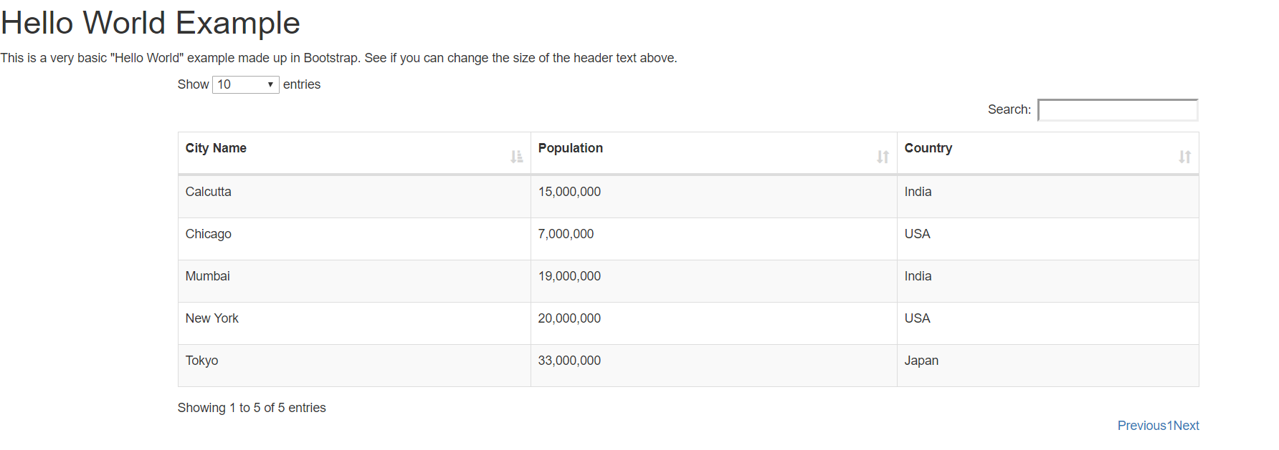
Execute
Note: Details about bootstrap and other template will be given later

Slide 58
Summary
Template Filters
Template Inheritance
  The use of “include”
  The use of “extends”
Template with Web Framework
  CSS
  Bootstraps

